Slide 1

Inventory tracking and management system
Ready to Start Aggregation

Slide 2
Introduction
Inventory management is a crucial aspect of business operations, ensuring efficient tracking, stock control, and data accuracy. Our Inventory Tracking and Management System is a React Native-based mobile application that streamlines inventory operations, providing real-time tracking, scanning, aggregation, dropout handling, reprinting, remapping, replacing, and user authentication.
Additionally, the system integrates E-Signature authentication, allowing users to digitally sign and approve transactions for enhanced security and compliance. This feature eliminates manual approvals, making processes more efficient and reducing errors.

Slide 3
Project Definition
The Inventory Tracking and Management System is designed to automate and optimize inventory tracking using barcode scanning, data aggregation, real-time updates, and e-signature authentication.
This system ensures: ✅ Accurate stock monitoring through scanning & real-time updates. ✅ Secure and authorized inventory transactions via E-Signature authentication. ✅ Error reduction with dropout handling, reprinting, and remapping codes. ✅ Seamless integration with dynamic backend connectivity.
It is ideal for warehouses, retail businesses, logistics companies, and manufacturing units requiring fast, secure, and accurate inventory tracking solutions.

Slide 4
Project Profile
Project Name: Inventory Tracking & Management System
Developed By: Hiren Parmar
Technology Stack: React Native, Node.js, PostgreSQL
Target Users: Warehouse Managers, Retailers, Manufacturers, Logistics Personnel

Slide 5
Tools and Technologies
Frontend:
React Native (Cross-Platform Mobile App)
React Navigation (Navigation Handling)
Axios (API Integration)
Backend:
Node.js & Express.js (REST API)
PostgreSQL (Database Management)
Prisma ORM (Database Querying)
Other Technologies:

Slide 6
Modules
Authentication Module – Secure login/logout functionality
Aggregation – Collecting and managing scanned inventory data
ScanList – Barcode scanning and real-time tracking
Dropout – Handling transaction failures and data loss prevention
Reprint – End transaction after reprint implement
Code Replace – Updating and replacing inventory records
Remap – Find the untracking items
E-Signature Authentication – Digital approval for inventory transactions
Settings Module – User preferences & system configurations
Dynamic Backend URL Configuration – Multi-server connectivity

Slide 7
Functionalities
✔ Real-time inventory scanning & tracking ✔ Secure user authentication with login/logout ✔ Dynamic backend URL configuration for multi-server access ✔ Dropout handling, reprinting, and remapping codes for accuracy ✔ E-Signature authentication for inventory approvals ✔ User role management (Warehouse Staff, etc.) ✔ Data aggregation and reporting for business insights

Slide 8
Users of the System
General Application Users (Warehouse Staff, Retailers, etc.):
Perform scanning, data aggregation, and item tracking
Submit approvals using E-Signature authentication
Access settings and configurations

Slide 9
GUI Design (Application)

Slide 10
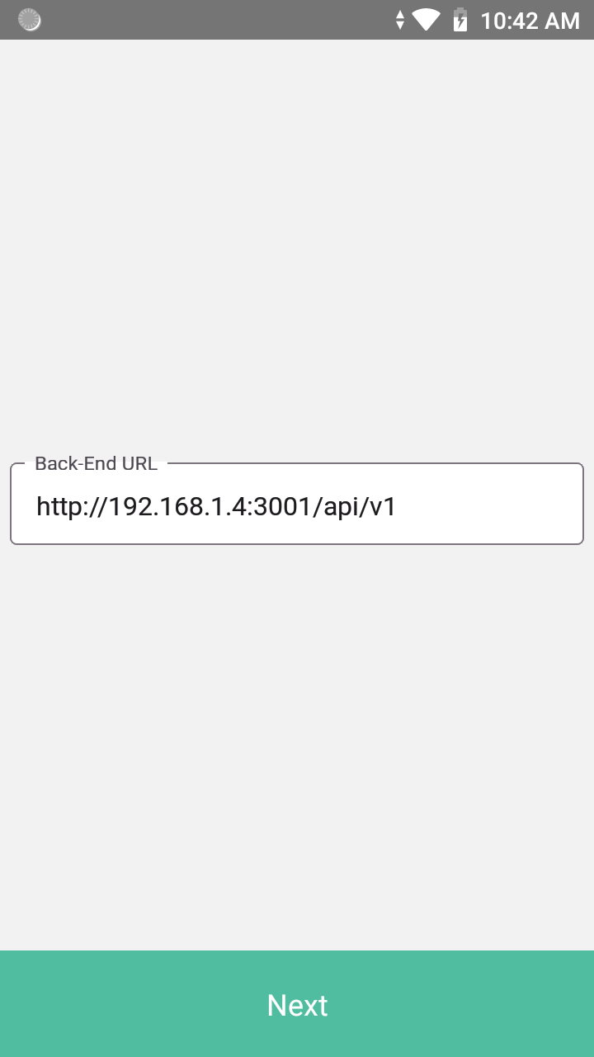
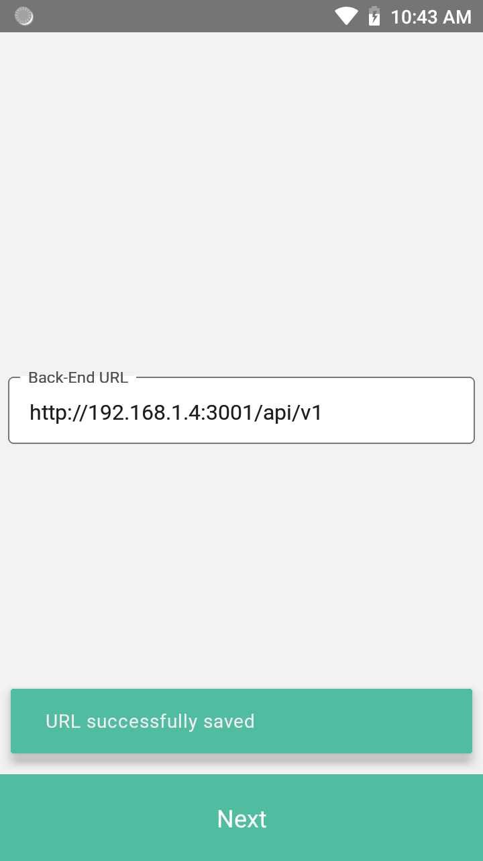
1. Dynamic Backend Connection

Slide 11
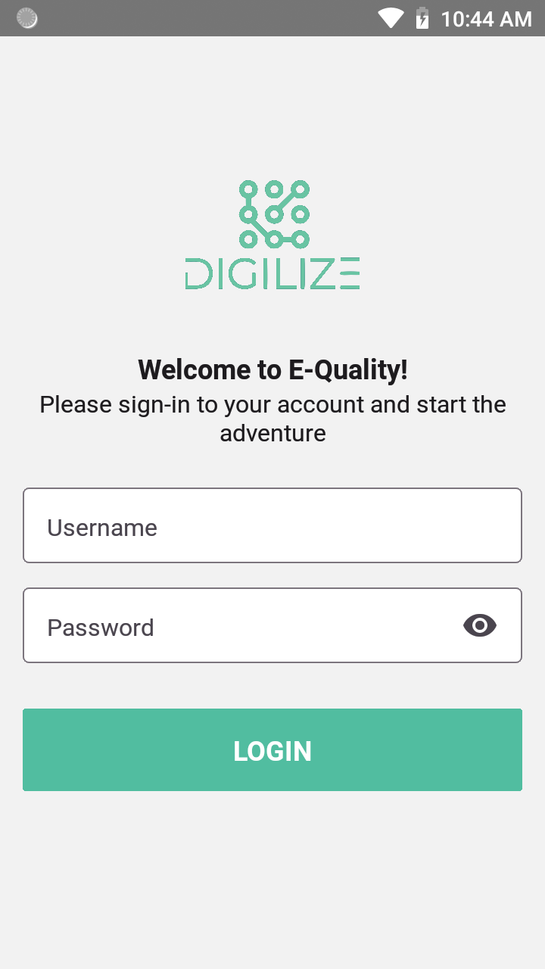
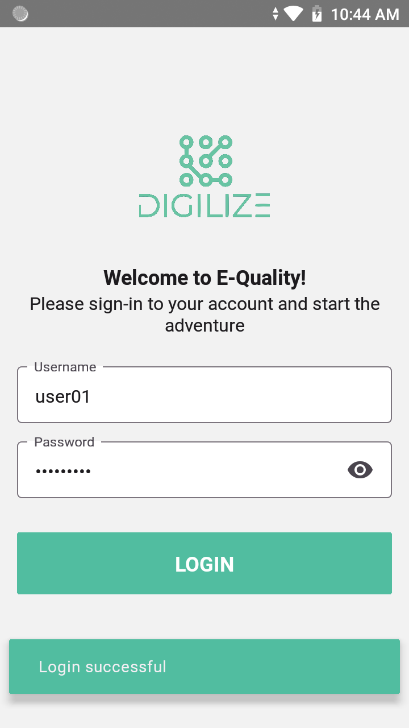
2. Login Screen

Slide 12
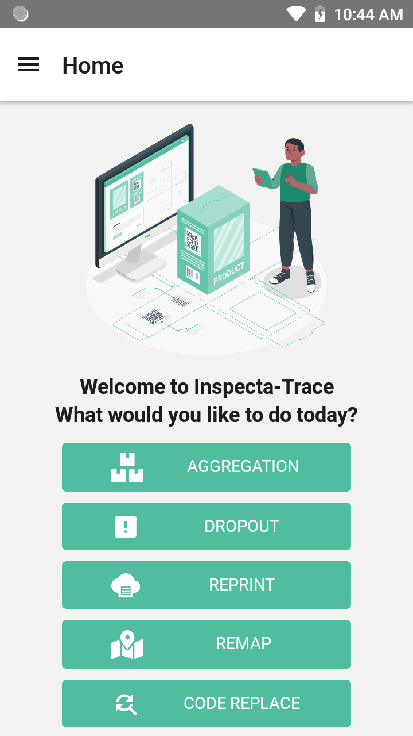
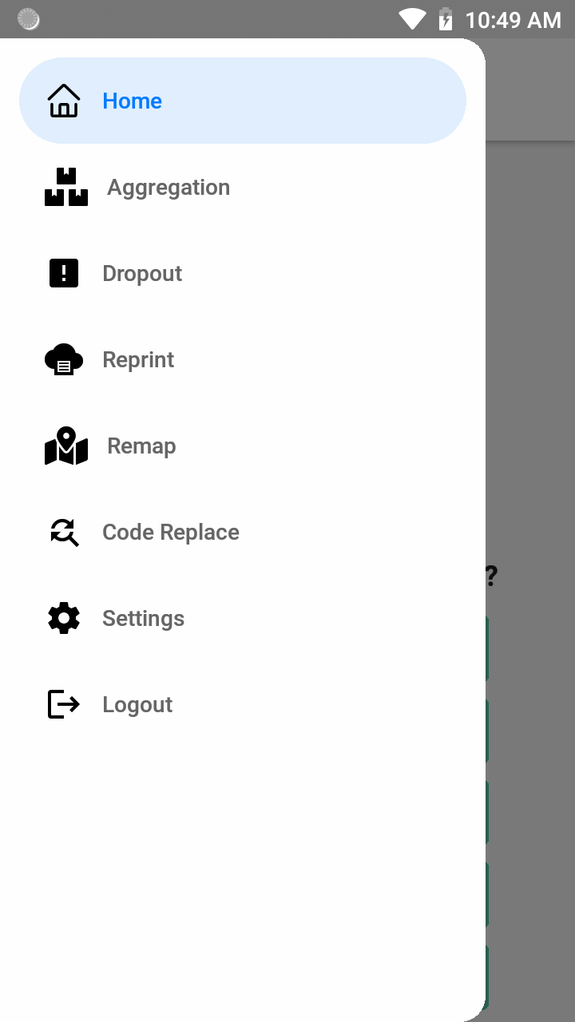
3.Home Screen

Slide 13
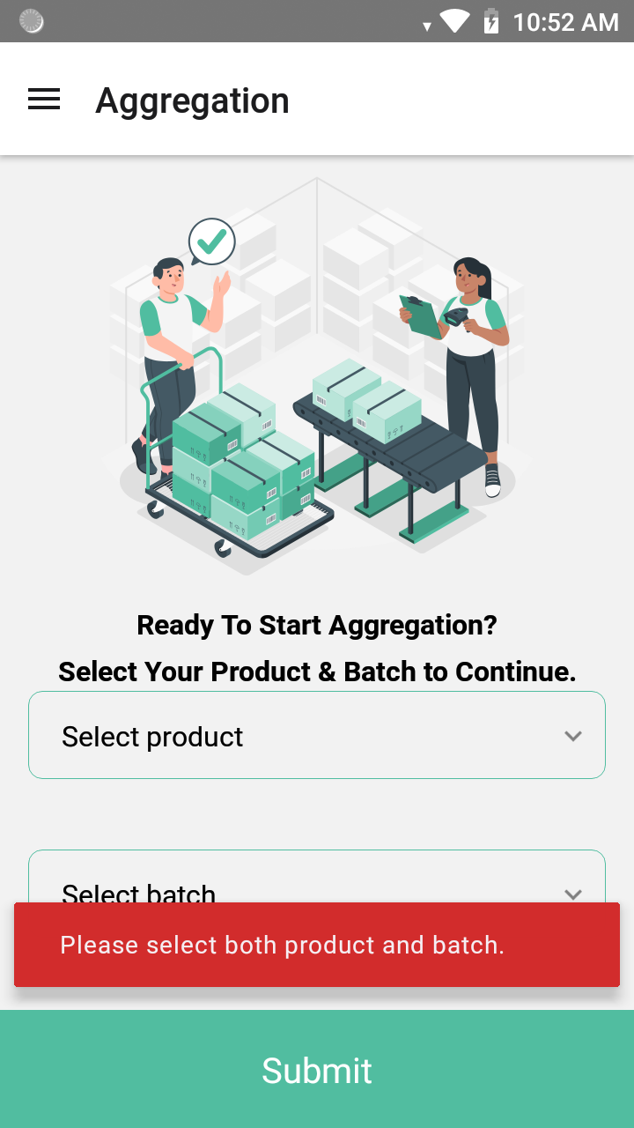
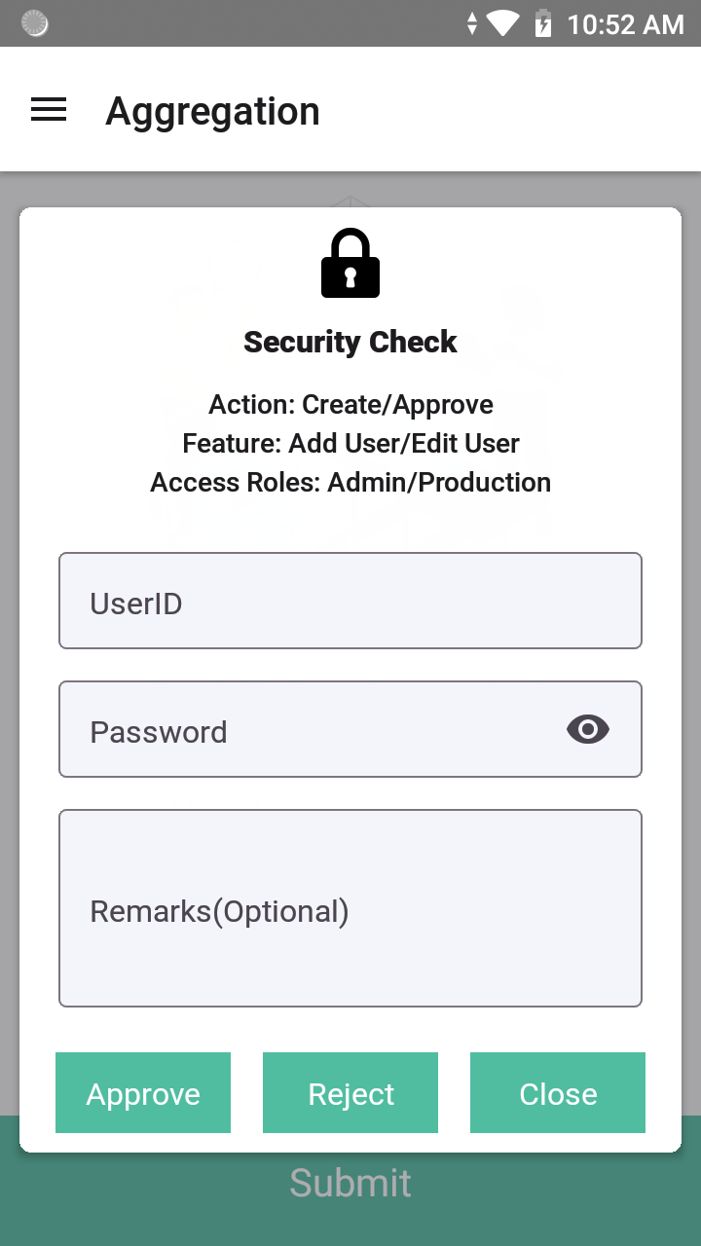
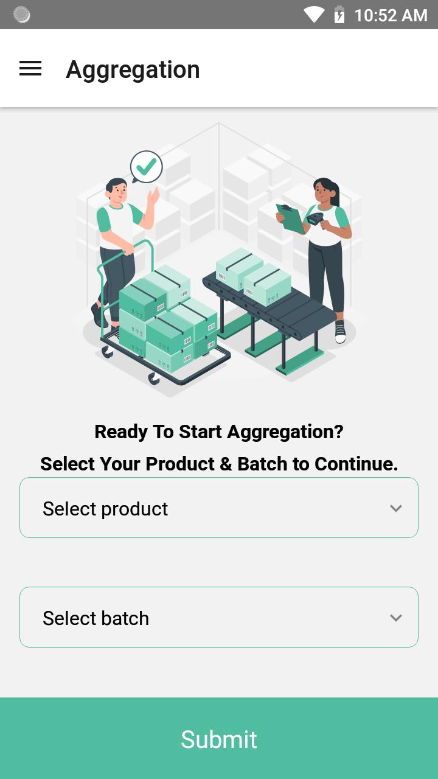
4. Aggregation

Slide 14
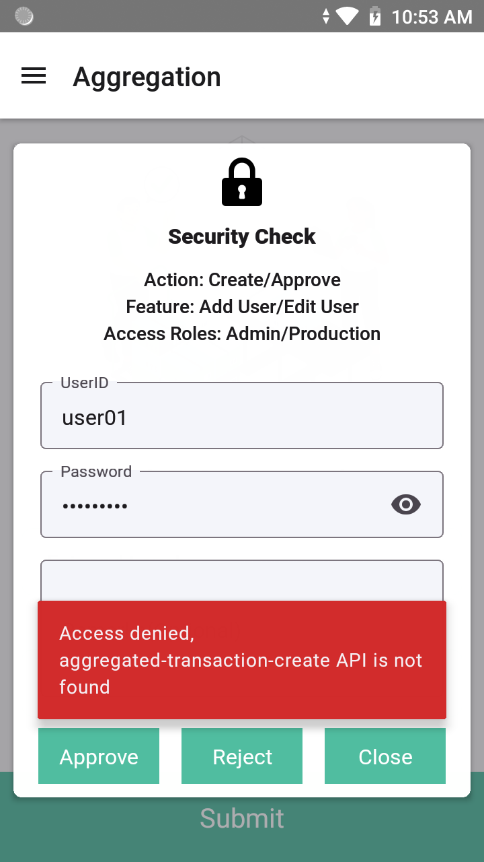
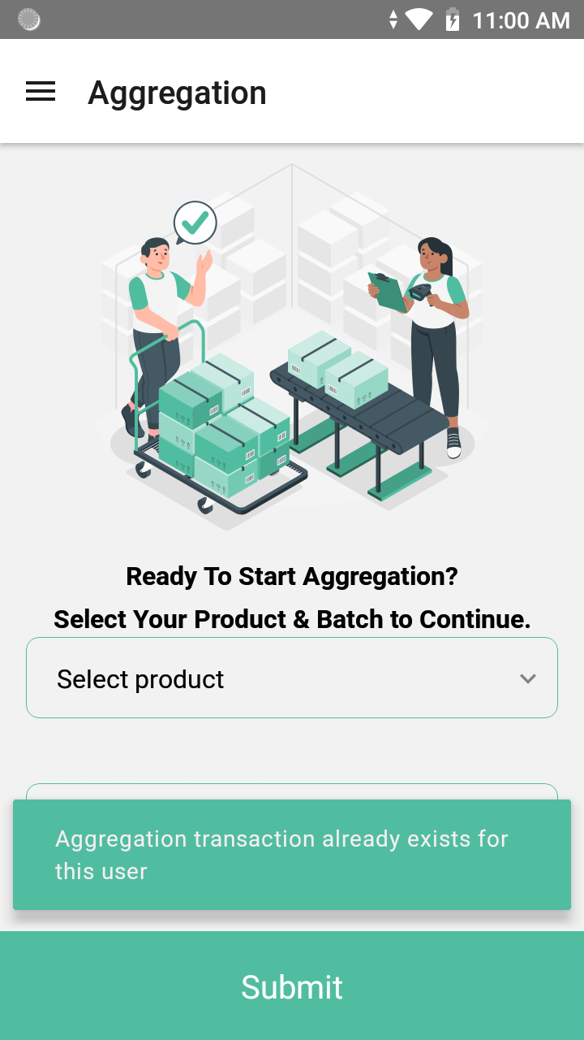
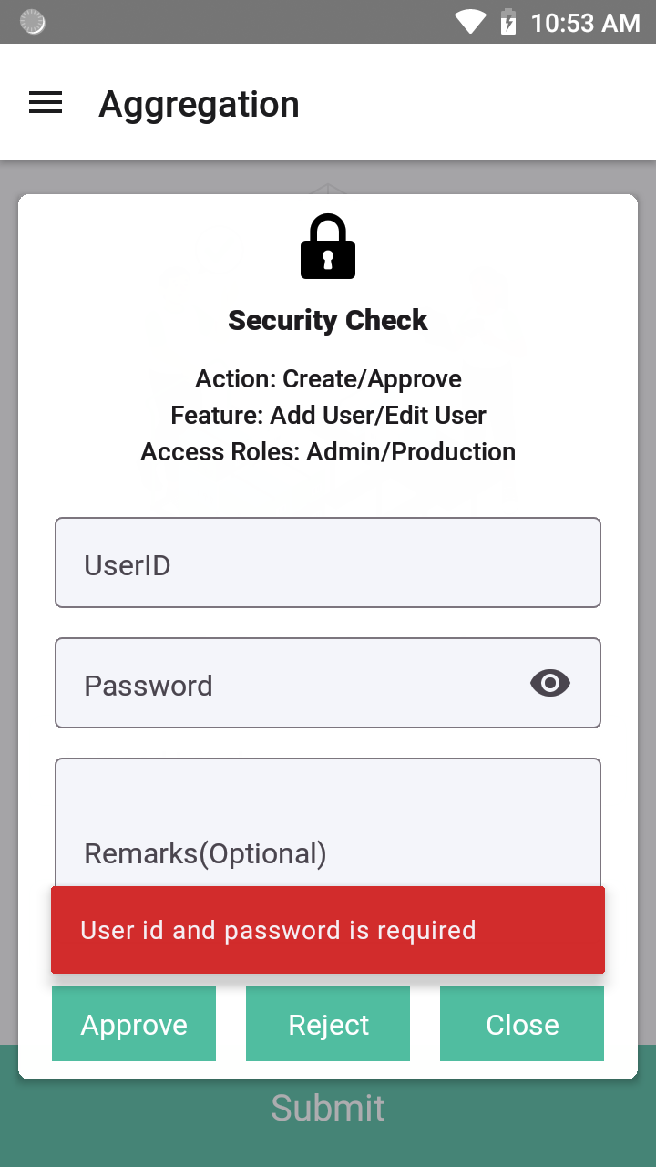
Aggrigation

Slide 15
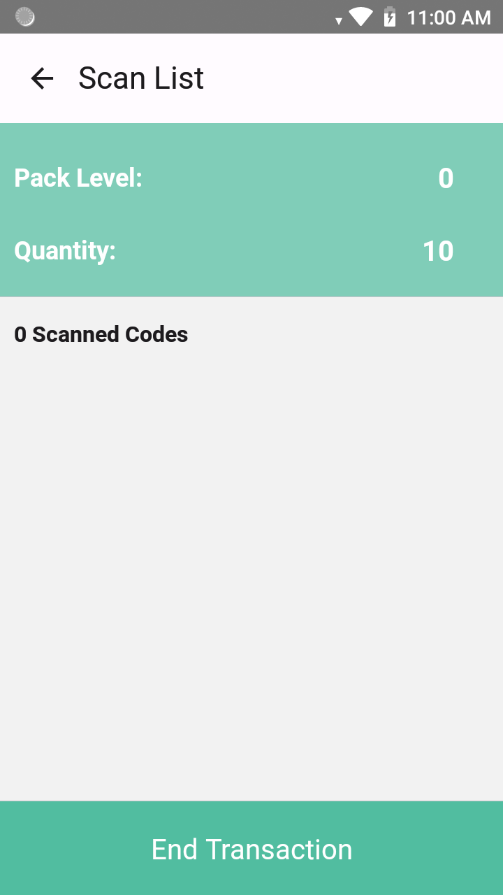
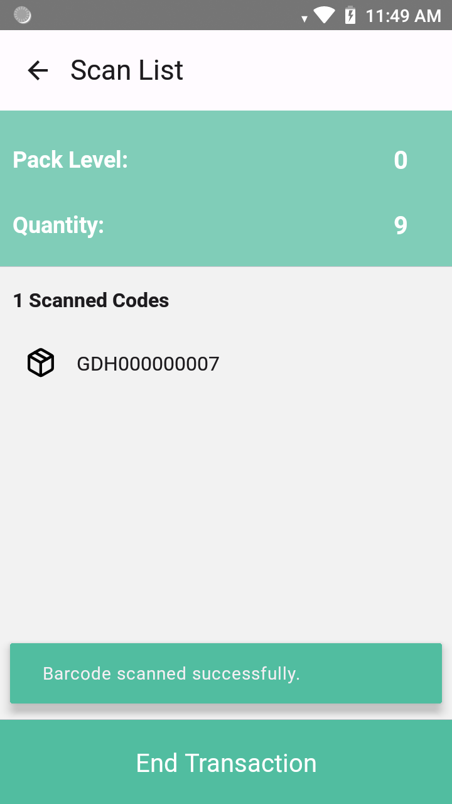
5. ScanList

Slide 16
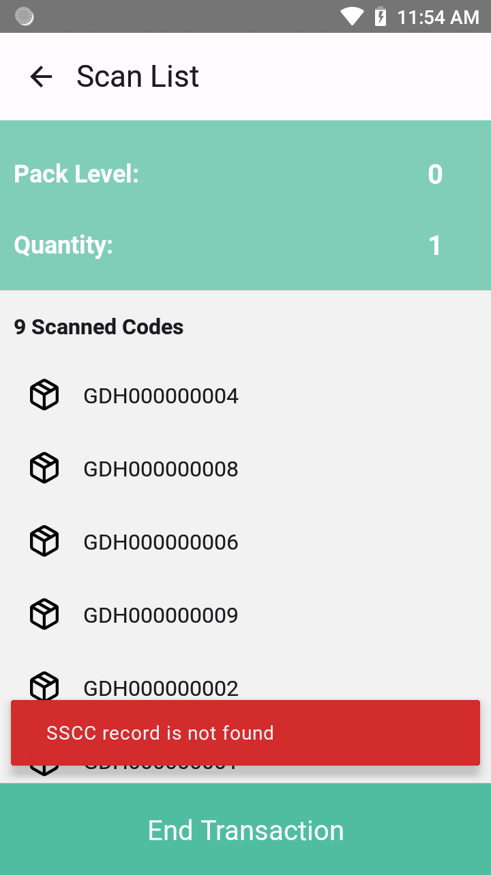
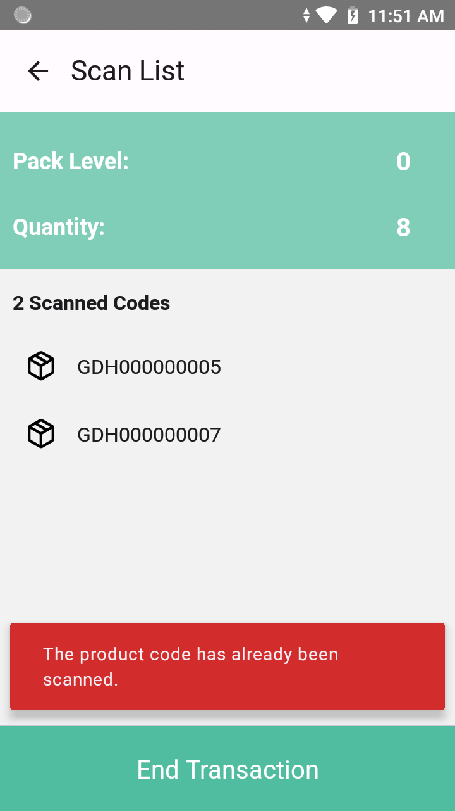
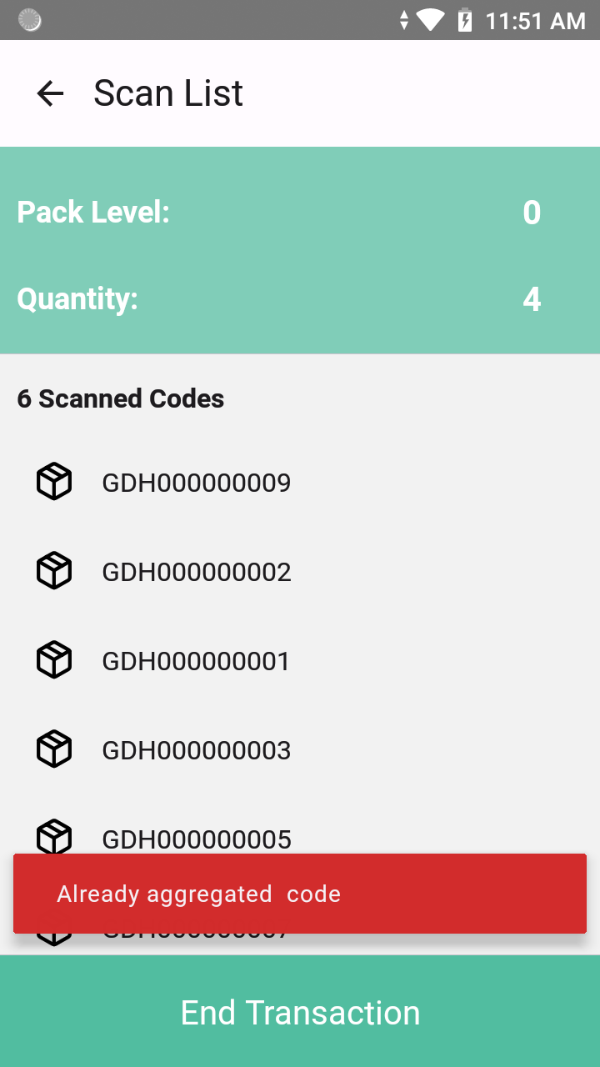
Scan Validations

Slide 17
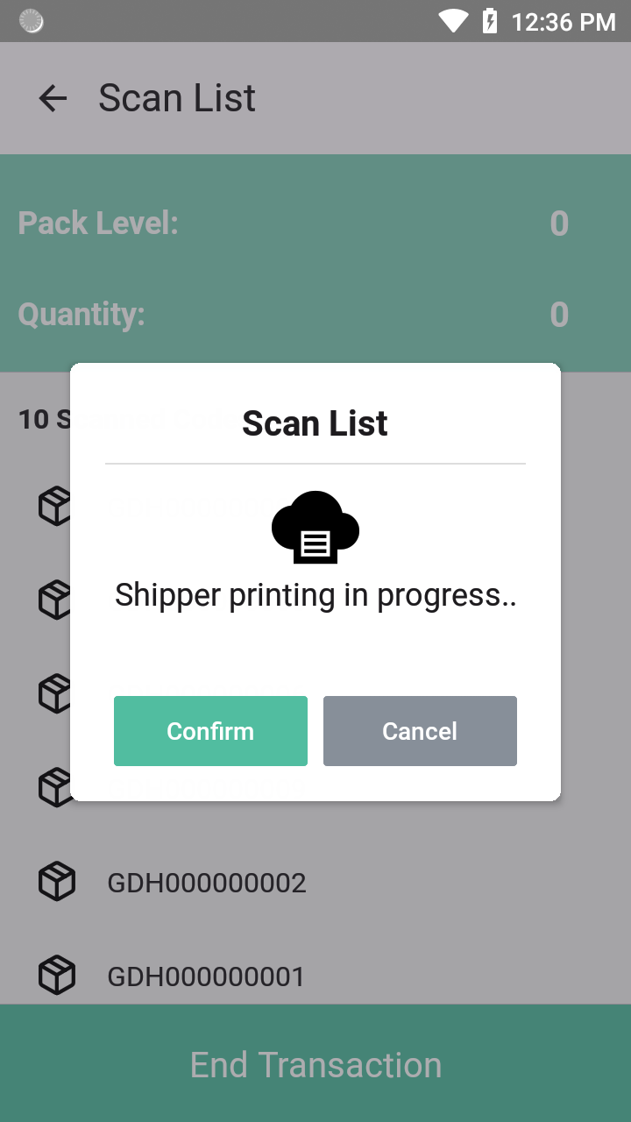
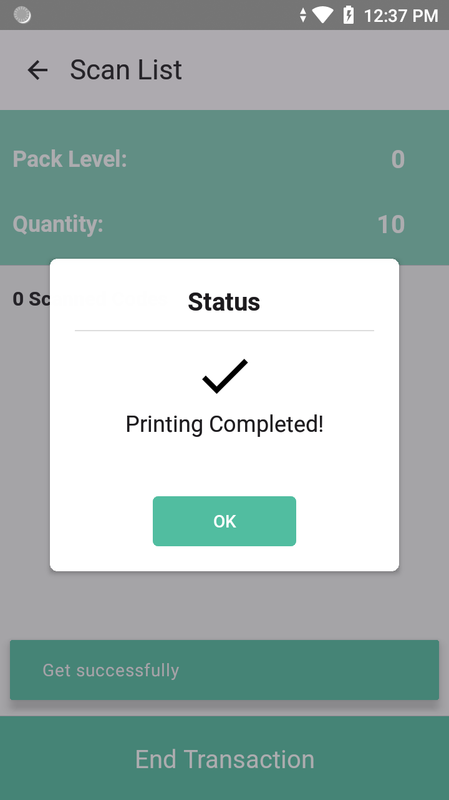
End Transaction

Slide 18
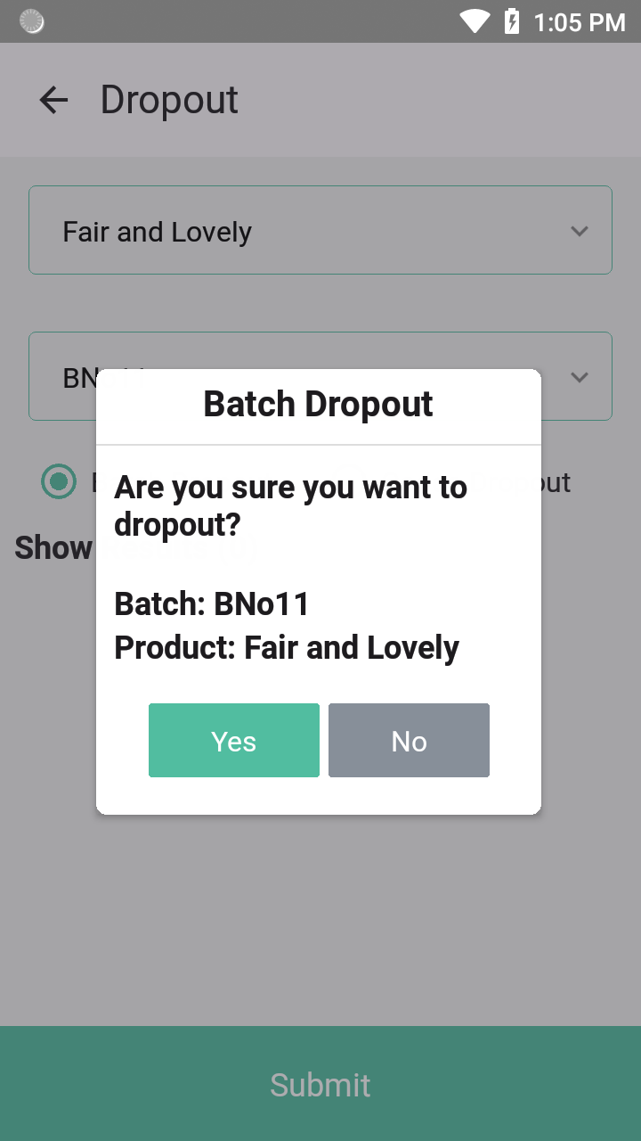
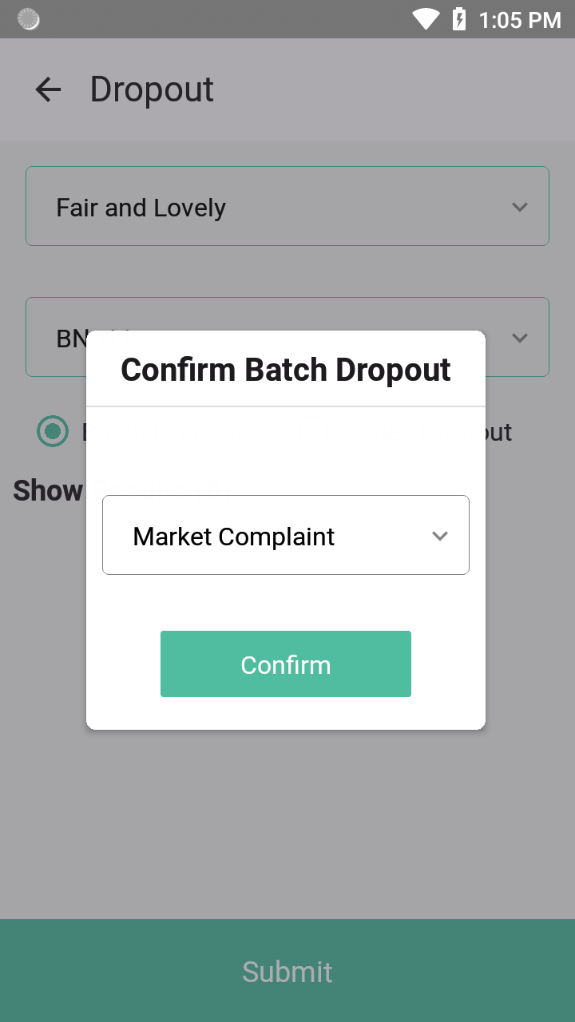
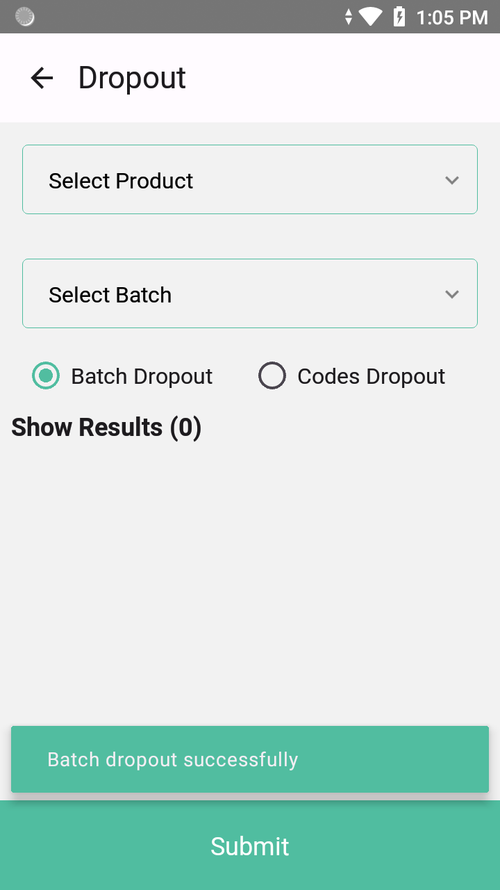
6. Dropout

Slide 19
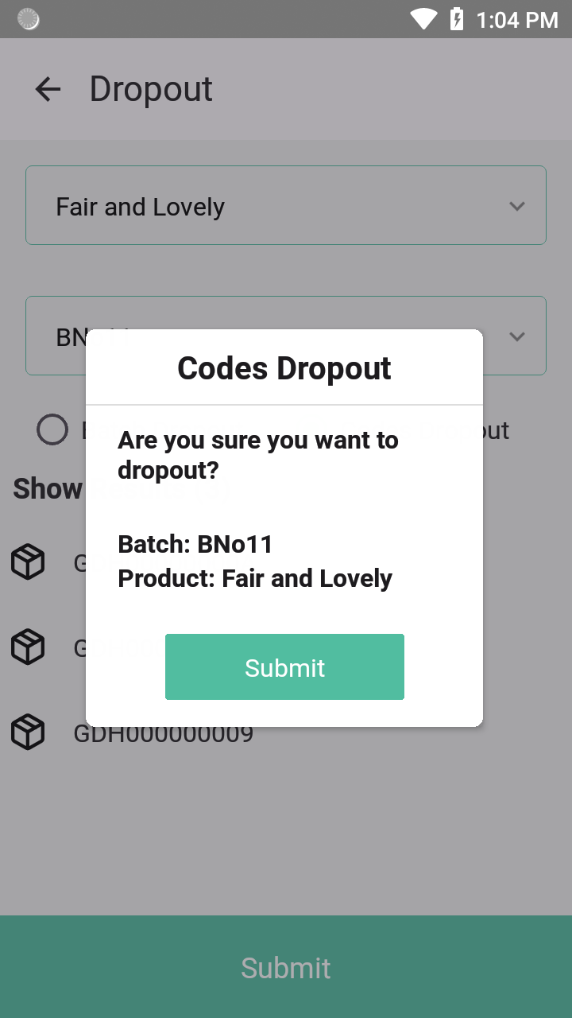
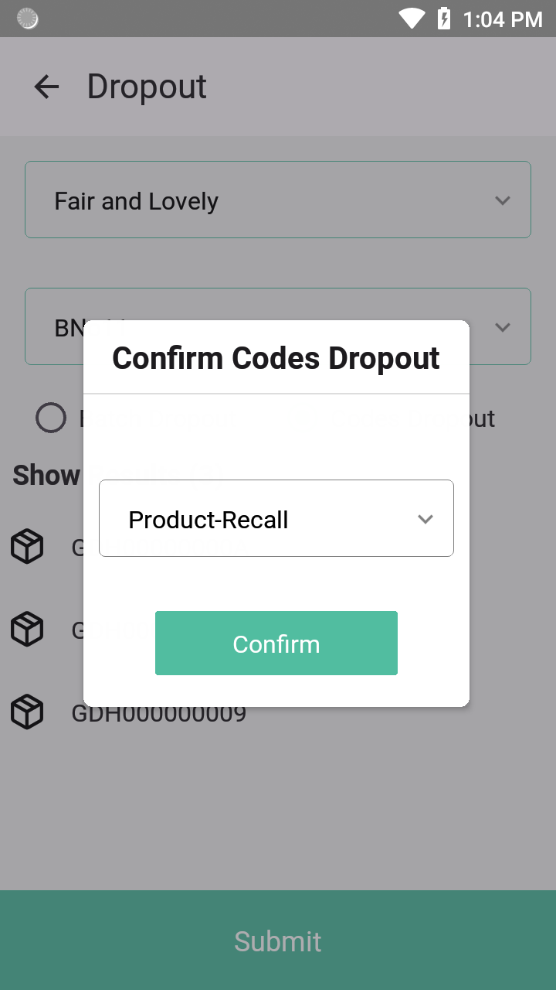
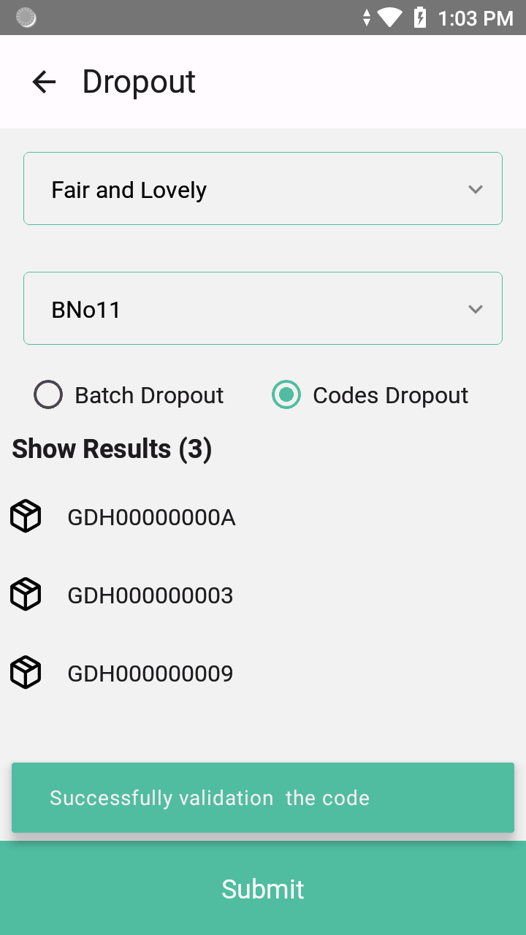
Codes Dropout

Slide 20
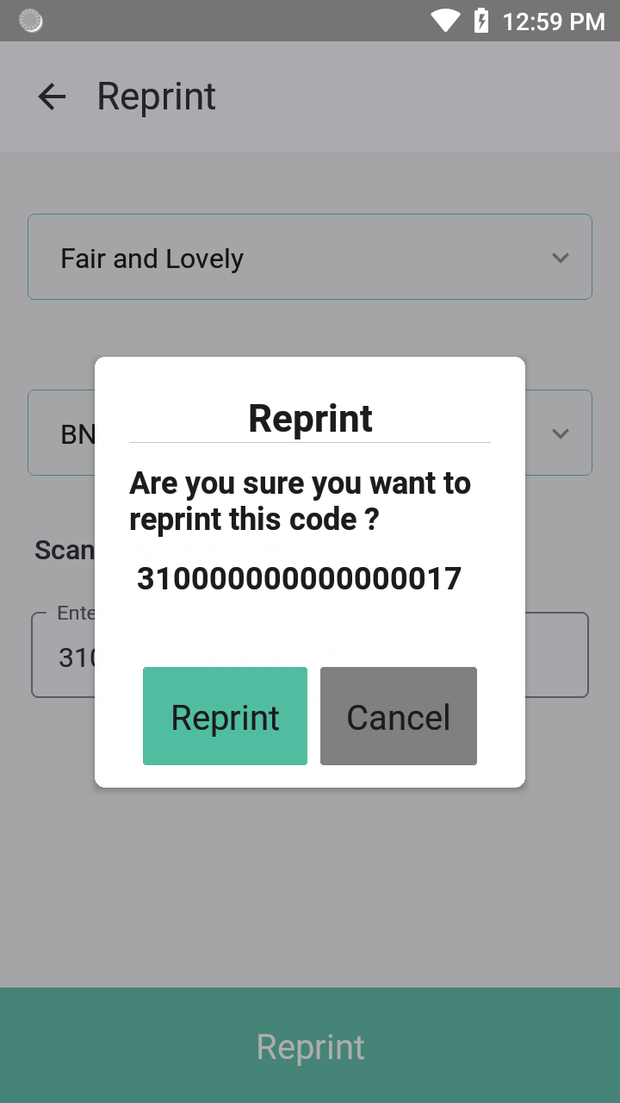
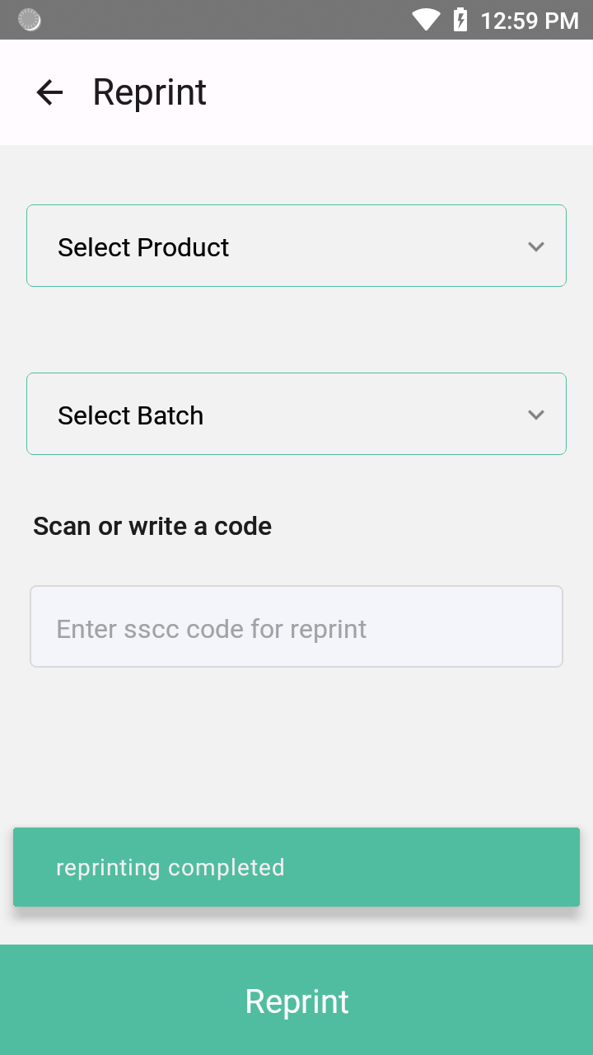
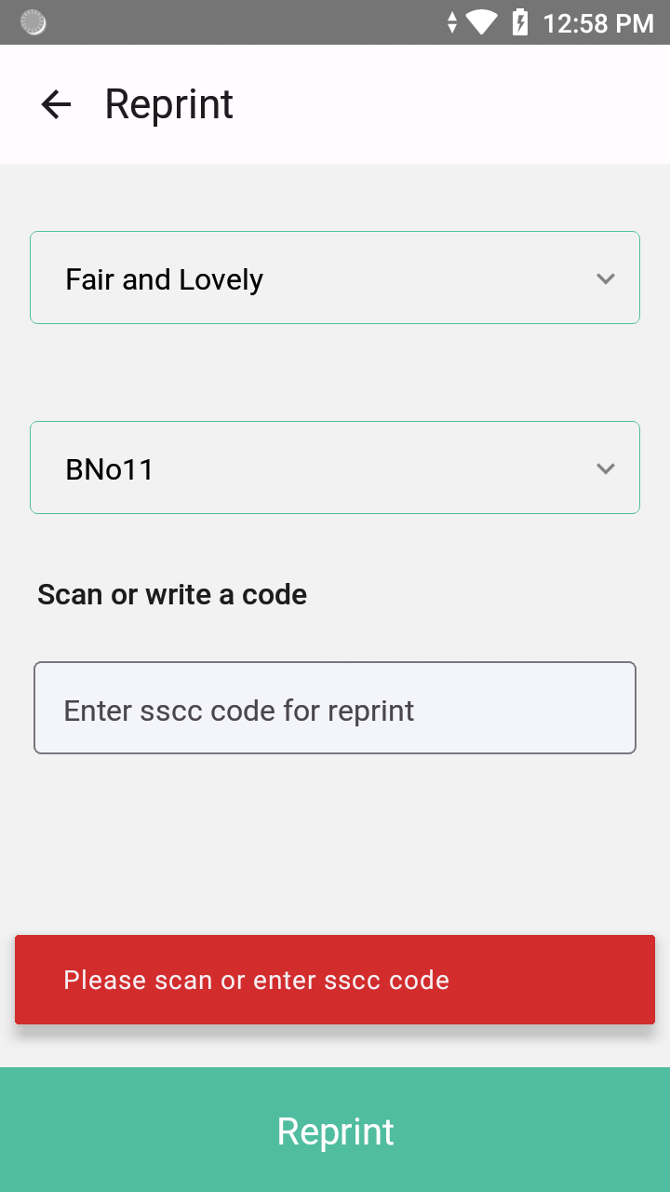
7. Reprint

Slide 21
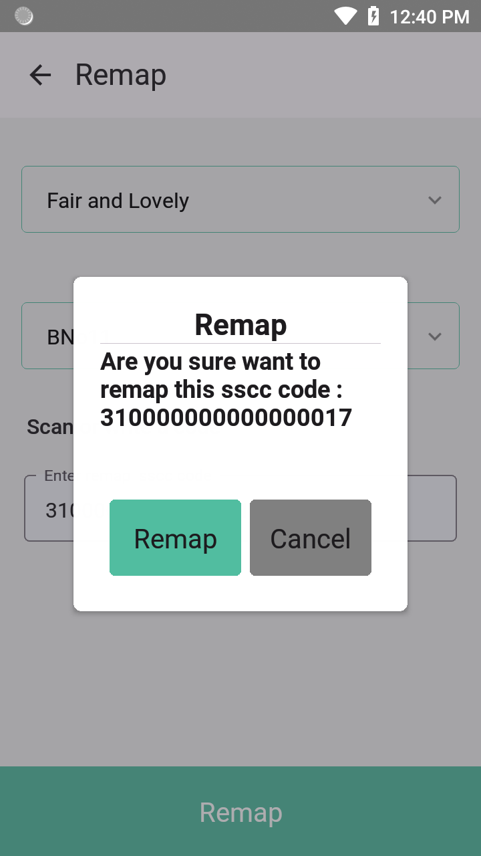
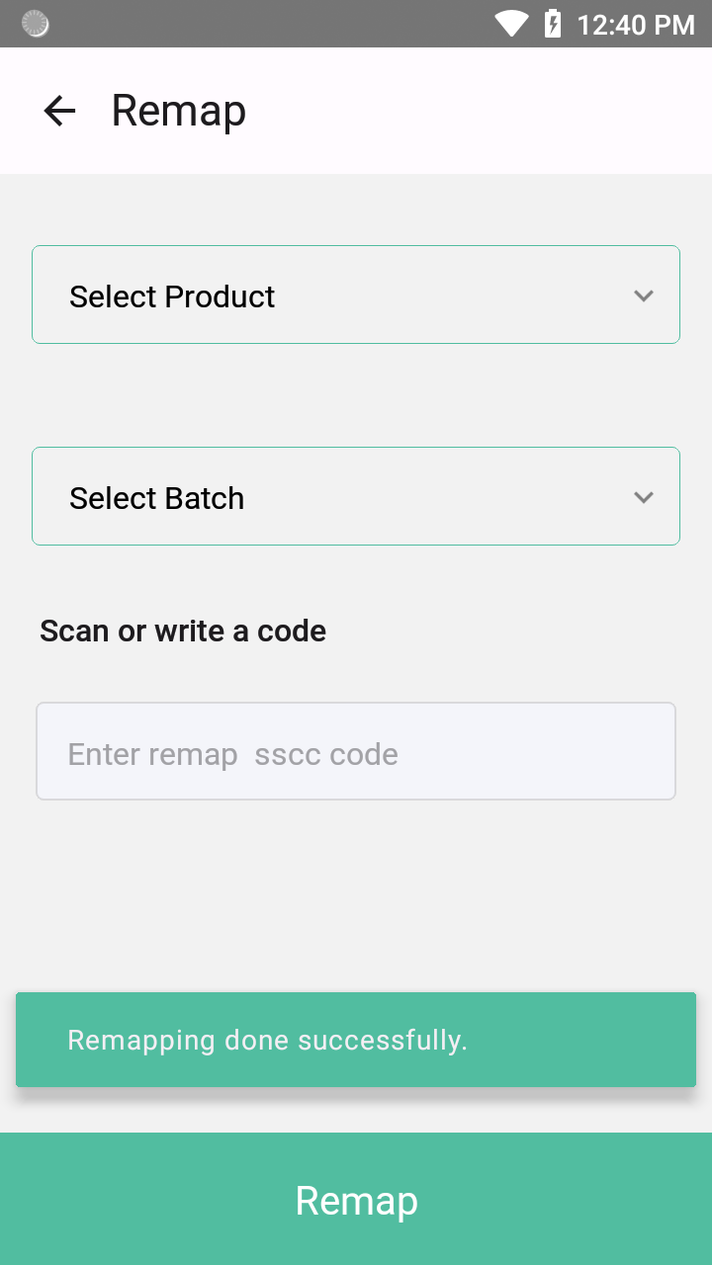
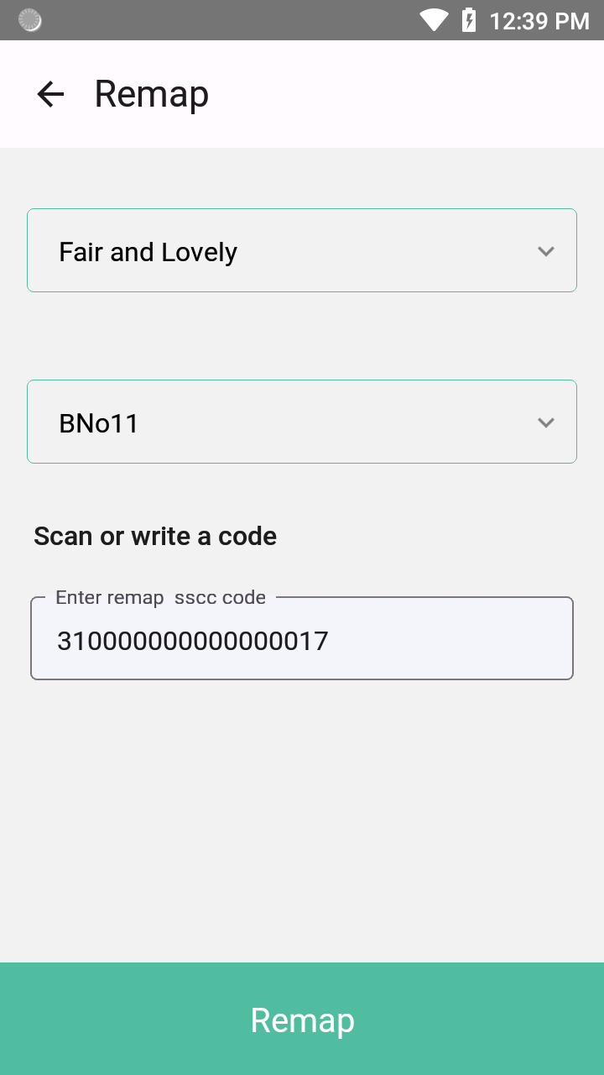
8. Remap

Slide 22
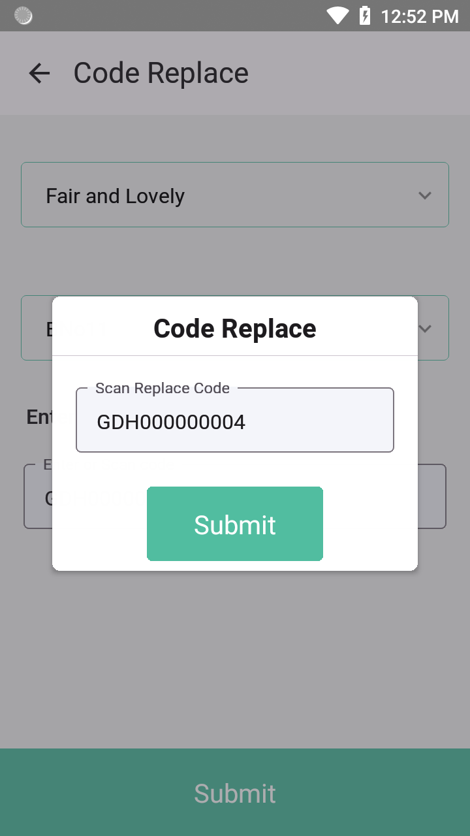
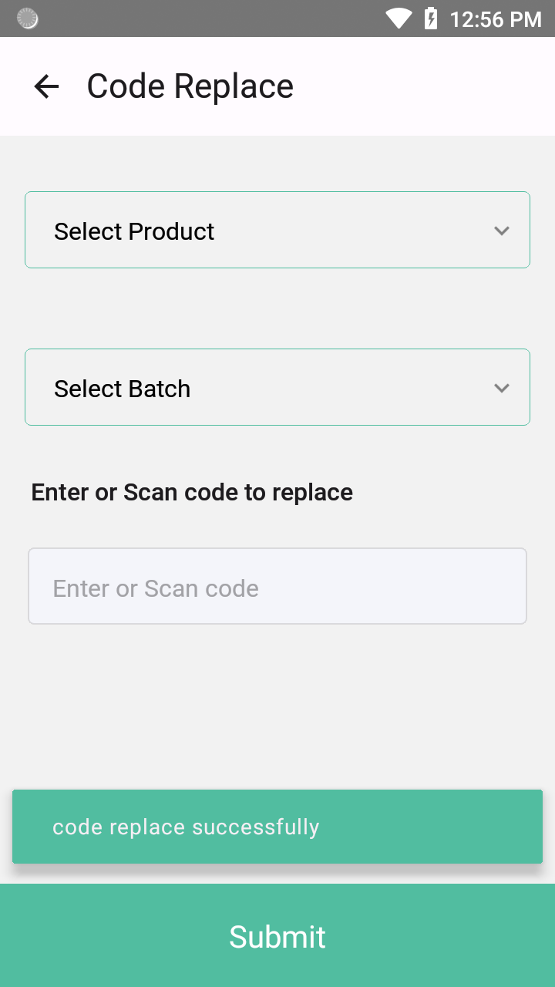
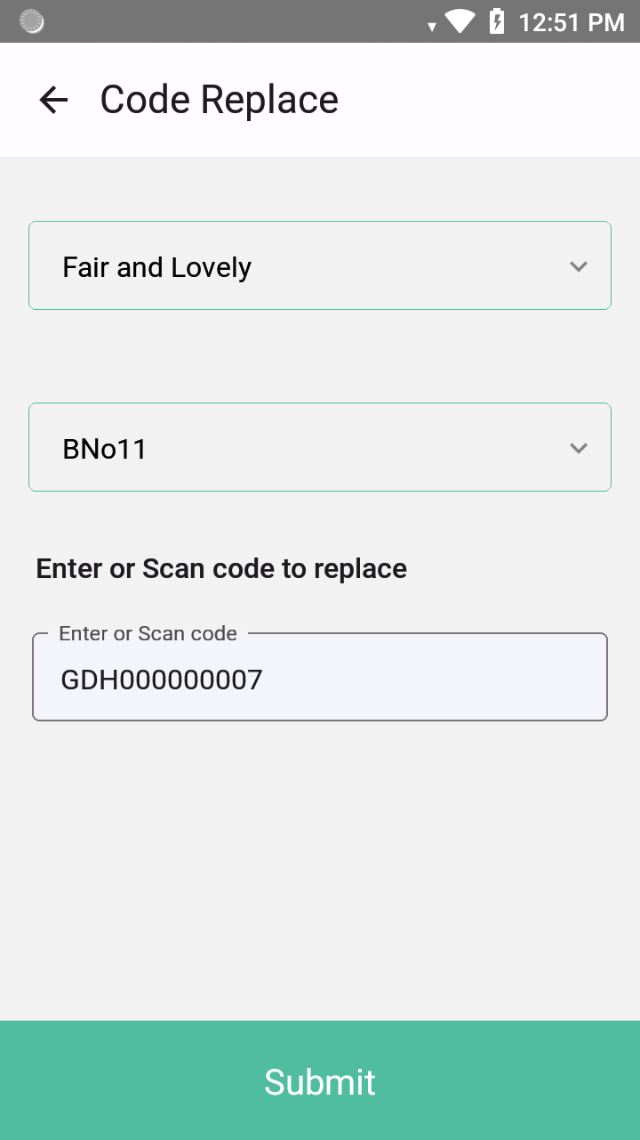
9. Code Replace

Slide 23
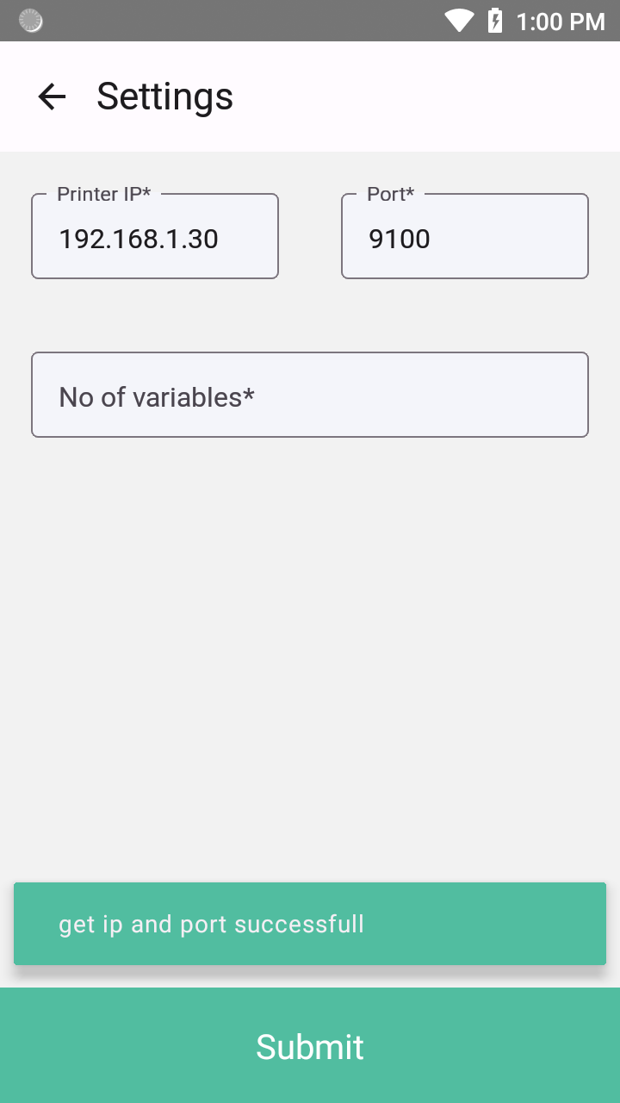
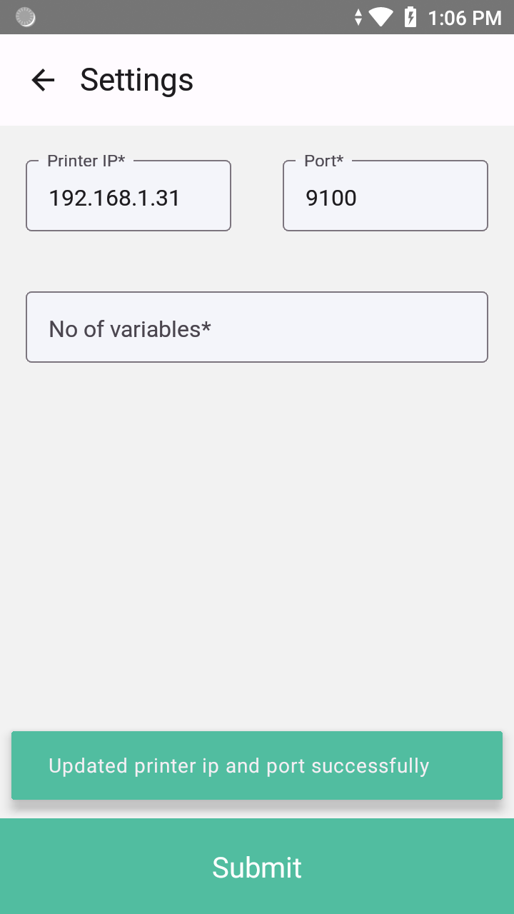
10. Settings

Slide 24
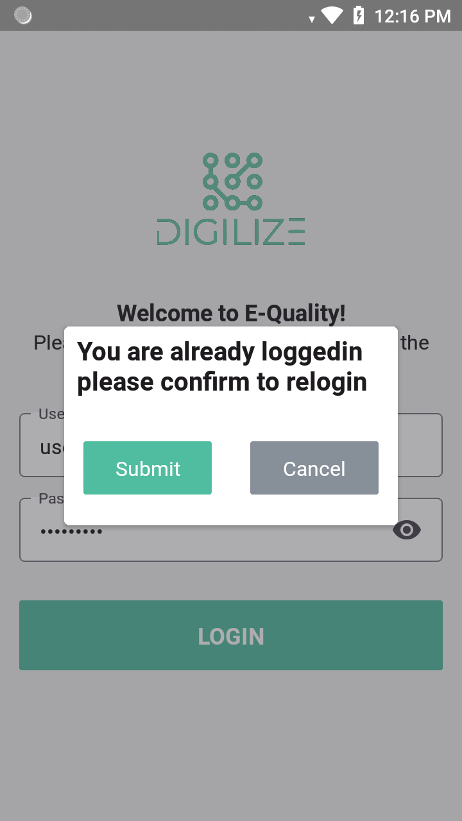
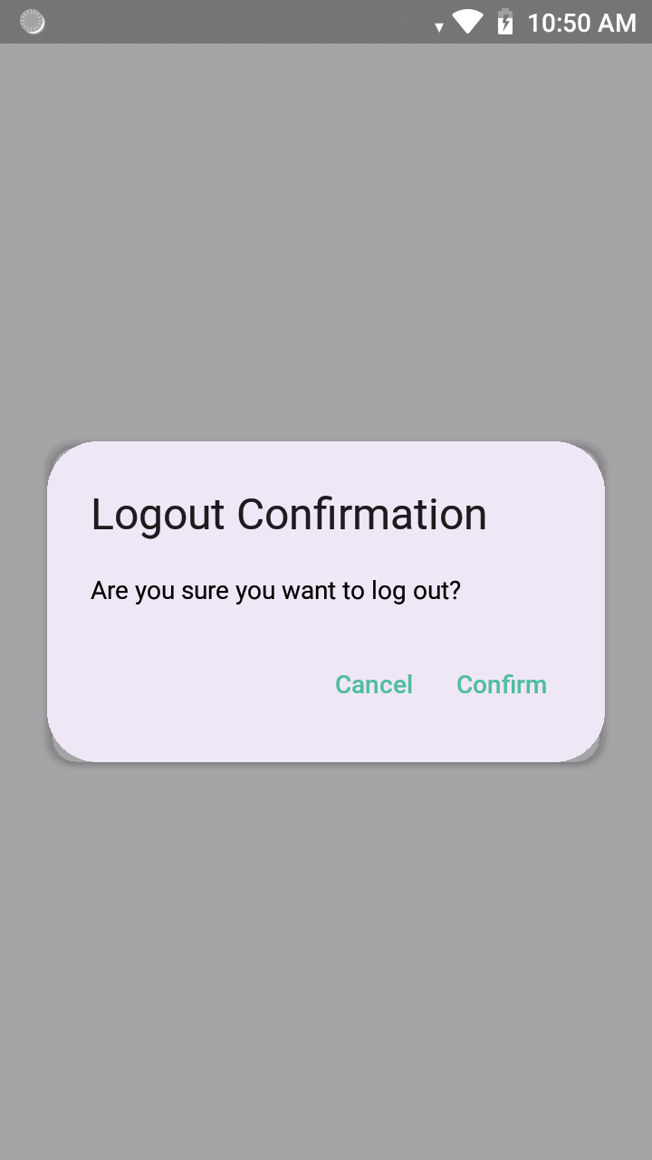
11. Logout

Slide 25
Conclusion
The Inventory Tracking and Management System provides a robust, efficient, and scalable solution for inventory management. With features like real-time scanning, aggregation, reprinting, remapping, replacing, and dropout handling, businesses can ensure accurate and secure stock control.
Additionally, E-Signature authentication enhances security by allowing authorized users to approve transactions digitally, eliminating manual approvals and reducing errors. The dynamic backend URL configuration offers flexibility in server connectivity, making the system adaptable for various business environments.
Future Enhancements:
Integration with IoT devices for automated inventory tracking

Slide 26
Bibliography
https://reactnative.dev/docs/getting-started
https://react.dev/learn
https://nextjs.org/docs
https://www.npmjs.com/package/@nextup/react-native-honeywell-scanner
https://www.prisma.io/
https://nodejs.org/docs/latest/api/
https://expressjs.com/
https://reactnativepaper.com/
https://www.postgresql.org/docs/
https://mui.com/material-ui/getting-started/

Slide 27
Thank You

